Slide 1
Bluetooth
v2.0 v2.1 v3.0 v4.0 v4.1 v4.2 v5.0

Slide 2
Outline
Overview
Bluetooth v2.0 + EDR, v2.1 + EDR
Bluetooth v3.0 + HS
Bluetooth v4.0
Bluetooth v4.1
Bluetooth v4.2
Bluetooth v5.0

Slide 3
Overview(v2.0+EDR, v2.1+EDR)
This version of the Bluetooth v2.0 Core Specification was released in 2004.
Bluetooth Core Specification Version 2.1 + EDR was adopted by the Bluetooth SIG on 26 July 2007.
Both Version 2.0 and 2.1 support EDR (Enhanced Data Rate), a faster PSK modulation scheme capable of transmitting data 2 or 3 times faster than previous versions of Bluetooth.

Slide 4
Bluetooth v2.0+EDR
EDR uses a combination of GFSK (Gaussian frequency-Shift Keying) and Phase Shift Keying modulation (PSK) with two variants, π/4-DQPSK and 8DPSK.
EDR can provide a lower power consumption through a reduced duty cycle.

Slide 5
Bluetooth v2.1+EDR
A feature called Sniff Subrating extends battery life by reducing the active duty cycle of Bluetooth devices like keyboards and mice to improve battery life.
Bluetooth hosts can specify maximum transmit and receive latencies so that low-power devices can know how often they must exit and re-enter “sniff mode”.
Notes:
藍牙2.1版加入了Sniff Subrating的功能，透過設定在2個裝置之間互相確認訊號的發送間隔來達到節省功耗的目的。一般來說，當2個進行連結的藍牙裝置進入待機狀態之後，藍牙裝置之間仍需要透過相互的呼叫來確定彼此是否仍在聯機狀態，當然，也因為這樣，藍牙芯片就必須隨時保持在工作狀態，即使手機的其它組件都已經進入休眠模式。為了改善了這樣這樣的狀況，藍牙2.1將裝置之間相互確認的訊號發送時間間隔從舊版的0.1秒延長到0.5秒左右，如此可以讓藍牙芯片的工作負載大幅降低，也可讓藍牙可以有更多的時間可以徹底休眠。

Slide 6
Overview(v3.0)
Launched in July, 2009, the Bluetooth v3.0 + HS (High Speed) was aimed at increasing the throughput of data exchanged over a Bluetooth connection.
Through version 3.0, a further reduction in the power consumption of Bluetooth devices has been achieved.

Slide 7
Bluetooth v3.0 + HS
Bluetooth v3.0 + HS provides theoretical data transfer speeds of up to 24 Mbit/s.
The main new feature is AMP (Alternative MAC/PHY), the addition of 802.11 as a high speed transport.
Enhanced Power Control, L2CAP Enhanced mode.

Slide 8
Bluetooth v3.0 + HS
Bluetooth Alternate MAC/PHY Approach(AMP)
Bluetooth link used to discover peer device, authenticate, discover capabilities (e.g., 802.11), and initiate operation.
802.11 link enabled and used when higher performance required.
802.11 link idled when operation completed.
With the combination of a 802.11 link, Bluetooth 3.0 devices can provide a maximum data transfer rate of 24 Mbps.

Slide 9
Bluetooth v3.0 + HS
L2CAP Enhanced modes
Enhanced Retransmission Mode (ERTM):
This mode is an improved version of the original retransmission mode. This mode provides a reliable L2CAP channel.
Streaming Mode (SM):
This is a very simple mode, with no retransmission or flow control. This mode provides an unreliable L2CAP channel.

Slide 10
Bluetooth v3.0 + HS
Enhanced Power Control
By supporting more than one modulation scheme, the power control is enhanced and so is the range.
The radio is utilized for the initial startup operations, like device discovery, initiating connections, and profile configurations. Thus, by utilizing the Wi-Fi radio, the power consumption can be minimized from the classic Bluetooth.
In the standby mode, the v3.0+HS disables the 802.11 link and only maintains the Bluetooth so as to have low power consumption.

Slide 11
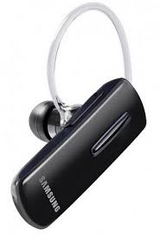
Bluetooth v3.0 + HS
Many wireless headphones operate with 3.0 technology which allows for a faster transfer rate at 20 megabits per second, as well as enhanced power control.
A smartphone can adjust to operate at the minimum power level needed to still retain a quality connection with your wireless headphones.

Slide 12
Overview(v4.0)
The Bluetooth SIG completed the version 4.0 and has been adopted as of 30 June 2010.
It includes Classic Bluetooth, Bluetooth high speed and Bluetooth low energy protocols.
Bluetooth high speed is based on Wi-Fi, and Classic Bluetooth consists of legacy Bluetooth protocols.
Single mode v.s. Dual mode
Bluetooth Low Energy(BLE)

Slide 13
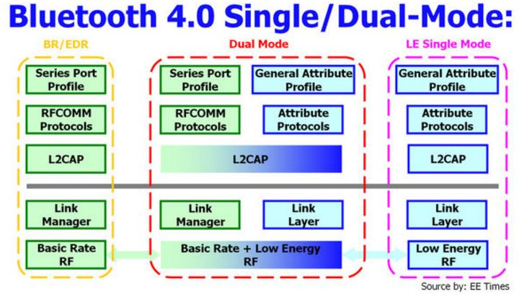
Single mode v.s. Dual mode
圖片來源：http://s90304a123.pixnet.net/blog/post/43179931-%E8%97%8D%E7%89%994.0-ble
Notes:
Bluetooth 4.0技術的核心架構可以參考上圖方塊圖所示，其中圖中左半部為傳統的標準藍牙技術BR/EDR架構，而圖中右半部則是在此版本中新增加的低耗電單工(Bluetooth Low Energy, BLE)架構，不過最為特別就是圖中間部分的Dual-Mode雙工架構。我們可以輕易看出該雙工架構就是將BR/EDR架構以及BLE單工架構一起結合施行的模式，在此雙工模式下系統會根據當時的環境隨時切換使用不同的傳輸方式，因此理論上可以達到系統優化以及節省耗電量的目的。

Slide 14
Single mode v.s. Dual mode
Why is dual-mode Bluetooth support so crucial?
With support coming in new devices and many users who have older devices, there are more years before Bluetooth low energy is more ubiquitous and almost all smartphone and tablets will continue to do support Bluetooth “classic.”
Bluetooth classic support in single-mode or dual-mode form will continue to be needed in applications as well.
Notes:
Single mode只能與BT4.0互相傳輸無法向下相容（與3.0/2.1/2.0無法相通）;Dual mode可以向下相容可與BT4.0傳輸也可以跟3.0/2.1/2.0傳輸.
加上目前大部分的裝置還未支援到4.0,因此雙功模式可以有效的並融過去的版本,加上可以針對不同應用做改變(下一頁舉例)

Slide 15
Single mode v.s. Dual mode
Why is dual-mode Bluetooth support so crucial?
If your device is a wireless speaker or audio headset, it needs to have classic support to maintain the data rate and quality of the audio transmission.
If you are creating a peripheral like a Bluetooth mouse or keyboard, your device may need to communicate with classic devices in addition to Bluetooth low energy.
Dual-mode would give you the maximum number of attaches.
Notes:
Bluetooth可依據不同使用裝置切換不同工作情境，例如，在使用如Bluetooth耳機麥克風的時候 需要維持一定的data rate 和品質 可能需要3.0版本的高速傳輸
使用藍芽滑鼠或鍵盤時可以採取低功耗的模式
Dual-mode 可以最貼近使用上的需求

Slide 16
Single mode v.s. Dual mode
Single-mode Devices
These devices are stand-alone Bluetooth low energy devices (also known as “Smart” devices) optimized for small battery-operated devices with low cost and low power consumption in focus. A typical single-mode device is a heart rate sensor.

Slide 17
Single mode v.s. Dual mode
Dual-mode Devices
These devices (also known as “Smart Ready” devices) include both Bluetooth low energy technology and Classic Bluetooth technology. Dual-mode devices will rarely gain in power saving because they need to support both technology implementations; the power savings will only be achieved with the single-mode option. A typical dual-mode device is a mobile phone or PC.

Slide 18
Bluetooth low energy
Why BLE?
Number of markets for low energy technology.
The key of internet of things.
Cited advantages include:
Low power requirements, operating for "months or years" on a button cell.
Small size and low cost.
Compatibility with a large installed base of mobile phones, tablets and computers.

Slide 19
Bluetooth low energy
Design Goal?
Worldwide operation
Low cost
Short range
Robust
Low power consumption
Notes:
Robust:因為 ISM 用戶多會有干擾, 所以使用 adaptive frequency hopping, 降低或避開干擾, 另外也使用 CRC 機制檢查資料正確性
Low power consumption: BLE 設計的目標就是希望裝置可以維持"年"為單位的時間而不用換電池, 所以 low power 是一個最大的目標, 後續的 protocol design 也會有 low power 優化的策略

Slide 20
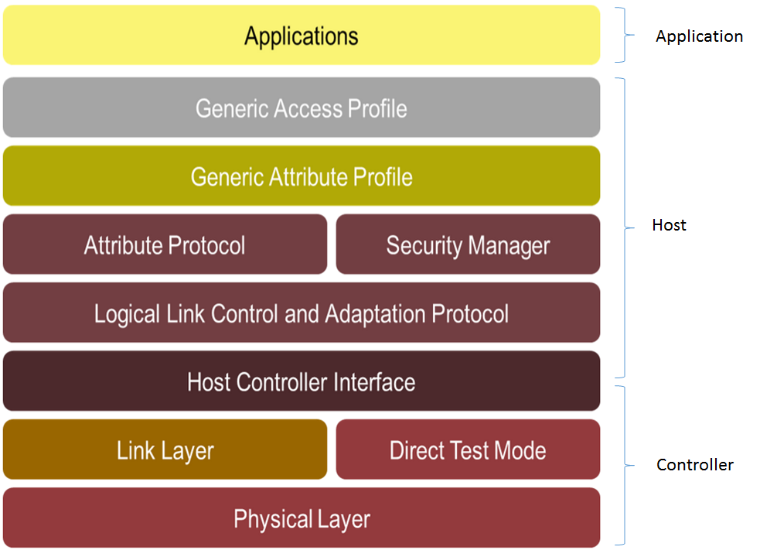
Bluetooth low energy
BLE Architecture
Controller Include hardware, dealing with TX/RX bluetooth packets.
Host It contains the upper layer of the stack including profiles and application API.
Notes:
Controller: 一般被稱作是 Bluetooth radio 或是 Bluetooth chip, 它包含了 RF 處理 analog / digital 的部分, 包含硬體的部分, 負責 TX/RX (傳送/接收) Bluetooth 封包.
Physical Layer:負責在 2.4 GHz 下做 radio TX/RX 的工作 ,Modulation scheme.
Direct Test Mode:用來測試 PHY 的功能, 大多的無線通訊技術其實對策是 PHY 並沒有一個標準, 所以有的公司會自己做自己的測試 PHY 的方式, 增加 Cost 的考量
Link Layer :主要功能是處理廣播 (advertising), 掃描 (scanning), 以及建立和保持連線 (connections), 並確保資料有正確的封包格式, 並執行 CRC check 以及處理加密
Host/Controller Interface:簡稱 HCI, 是 Host 用來跟 Controller 溝通的標準介面, 因為在傳統 BT 的架構下, 有 60% 的 Controller 是透過 HCI 來控制的 (也就是 Controller 是一顆獨立的 Chip 而 Host/App 再另一顆 Chip, 智慧手機就是一個例子)
Host : 做的事情有 Multiplexing (L2CAP), Authentication (SM), expose state data (Attribute
Protocol), 定義 Attribute Protocol 如何重複利用 services 來讓裝置的 characteristics 可以被存取到 (Generic Attribute Profile), 以及定義裝置如何找到其他裝置並做連線 (Generic Access Profile)
L2CAP :BLE 的 multiplexing Layer (簡單來說就是將資料用正確的格式分出去 or 聚集起來, 中文是多工 & 解多工)
Security Manager Protocol:
Attribute Protocol:負責 pairing 以及 key distribution,pairing 就是 device 之間互相取得信任的程序, pairing 後就會用加密的連線做 key distribution.key distribution 就是 slave 把加密資 訊送給 master, 所以重新連線後, 就可以用這個加密資訊來加密資料做安全性的傳輸.
Attribute Protocol:定義了存取 peer device (對方裝置) 資料的"規則"(Request,Response,Commands,Notifications ,Indications,Confirmations )
Generic Attribute Profile:位於 Attribute Protocol 的上層 (所以是 based on Attribute Protocol), 定義了 Attributes 的 Type 以及他們該如何被使用.
並定義了一些 procedures 來發現 services, characteristics, descriptors 並對 characteristics 做讀寫.
Generic Access Profile:定義了裝置如何成為 discoverable, connectable, bondable
定義了裝置如何利用程序 (procedures) 來 discover, connect, read device name, bond 其他裝置
Application Layer 在最上層, 定義了三種規範: characteristic, service, and profile
Characteristics
已知格式的資料, 伴隨一個 Universally Unique Identifier (UUID)
可以重複使用 (reusable), 所以沒有行為的定義 (no behavior), 因為一但有了行為的定義, 就不容易重複使用了
computer readable format, 需要透過 computer 協助顯示給 user
Services
是 human readable format 的資料
包含了多個 characteristics 以及對應的行為 (behavior), 所以 characteristic 到了一個 service 內才被賦予了行為 (behavior)
Service 只對定義 characteristics 在 Server 的行為, Client 的行為則不會定義 (Client 行為定義在 Profile)
Service 不是敘述裝置如何連線並找到和使用 service, 以及如何找到 characteristics, 而是敘述當 Server 的 characteristics 被讀寫 (以及 notified / indicated) 的時候, 會發生什麼事
Profiles
Profile 就是應用程式本身, 或是使用案例的一個體現
Profile 會敘述 2 到多個裝置, 每個裝置會有多個 services
Profile 會敘述裝置如何成為 discoverable 以及 connectable (間接定義了)
Profile 會敘述 Client 如何找到 Service, 找到 Characteristics, 以及如何去使用這些 Services 以達到目標的功能

Slide 21
Bluetooth low energy
BLE Architecture
Application Characteristics, Services, Profiles.
Notes:
Controller: 一般被稱作是 Bluetooth radio 或是 Bluetooth chip, 它包含了 RF 處理 analog / digital 的部分, 包含硬體的部分, 負責 TX/RX (傳送/接收) Bluetooth 封包.
Physical Layer:負責在 2.4 GHz 下做 radio TX/RX 的工作 ,Modulation scheme.
Direct Test Mode:用來測試 PHY 的功能, 大多的無線通訊技術其實對策是 PHY 並沒有一個標準, 所以有的公司會自己做自己的測試 PHY 的方式, 增加 Cost 的考量
Link Layer :主要功能是處理廣播 (advertising), 掃描 (scanning), 以及建立和保持連線 (connections), 並確保資料有正確的封包格式, 並執行 CRC check 以及處理加密
Host/Controller Interface:簡稱 HCI, 是 Host 用來跟 Controller 溝通的標準介面, 因為在傳統 BT 的架構下, 有 60% 的 Controller 是透過 HCI 來控制的 (也就是 Controller 是一顆獨立的 Chip 而 Host/App 再另一顆 Chip, 智慧手機就是一個例子)
Host : 做的事情有 Multiplexing (L2CAP), Authentication (SM), expose state data (Attribute
Protocol), 定義 Attribute Protocol 如何重複利用 services 來讓裝置的 characteristics 可以被存取到 (Generic Attribute Profile), 以及定義裝置如何找到其他裝置並做連線 (Generic Access Profile)
L2CAP :BLE 的 multiplexing Layer (簡單來說就是將資料用正確的格式分出去 or 聚集起來, 中文是多工 & 解多工)
Security Manager Protocol:
Attribute Protocol:負責 pairing 以及 key distribution,pairing 就是 device 之間互相取得信任的程序, pairing 後就會用加密的連線做 key distribution.key distribution 就是 slave 把加密資 訊送給 master, 所以重新連線後, 就可以用這個加密資訊來加密資料做安全性的傳輸.
Attribute Protocol:定義了存取 peer device (對方裝置) 資料的"規則"(Request,Response,Commands,Notifications ,Indications,Confirmations )
Generic Attribute Profile:位於 Attribute Protocol 的上層 (所以是 based on Attribute Protocol), 定義了 Attributes 的 Type 以及他們該如何被使用.
並定義了一些 procedures 來發現 services, characteristics, descriptors 並對 characteristics 做讀寫.
Generic Access Profile:定義了裝置如何成為 discoverable, connectable, bondable
定義了裝置如何利用程序 (procedures) 來 discover, connect, read device name, bond 其他裝置
Application Layer 在最上層, 定義了三種規範: characteristic, service, and profile
Characteristics
已知格式的資料, 伴隨一個 Universally Unique Identifier (UUID)
可以重複使用 (reusable), 所以沒有行為的定義 (no behavior), 因為一但有了行為的定義, 就不容易重複使用了
computer readable format, 需要透過 computer 協助顯示給 user
Services
是 human readable format 的資料
包含了多個 characteristics 以及對應的行為 (behavior), 所以 characteristic 到了一個 service 內才被賦予了行為 (behavior)
Service 只對定義 characteristics 在 Server 的行為, Client 的行為則不會定義 (Client 行為定義在 Profile)
Service 不是敘述裝置如何連線並找到和使用 service, 以及如何找到 characteristics, 而是敘述當 Server 的 characteristics 被讀寫 (以及 notified / indicated) 的時候, 會發生什麼事
Profiles
Profile 就是應用程式本身, 或是使用案例的一個體現
Profile 會敘述 2 到多個裝置, 每個裝置會有多個 services
Profile 會敘述裝置如何成為 discoverable 以及 connectable (間接定義了)
Profile 會敘述 Client 如何找到 Service, 找到 Characteristics, 以及如何去使用這些 Services 以達到目標的功能

Slide 22
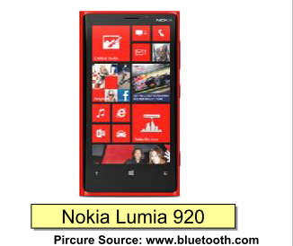
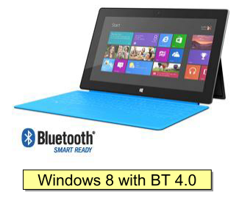
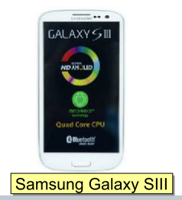
Bluetooth low energy
Application example
picture source:http://www.digitimes.com.tw/tw/B2B/Seminar/Service/download/053A111160/053A111160_LV4V0QPYH1B3JSHL8FPM.pdf

Slide 23
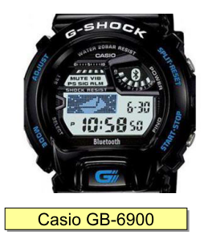
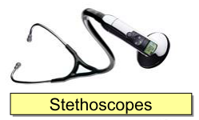
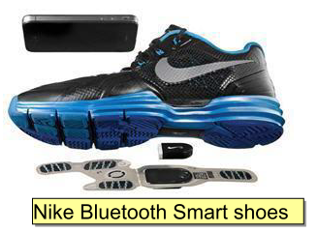
Bluetooth low energy
Application example
picture source:http://www.digitimes.com.tw/tw/B2B/Seminar/Service/download/053A111160/053A111160_LV4V0QPYH1B3JSHL8FPM.pdf

Slide 24
Bluetooth low energy
Network Topology
A Bluetooth Low Energy device can communicate with the outside world in two ways: broadcasting or connections.
Broadcasting
Using connectionless broadcasting, you can send data out to any scanning device or receiver in listening range.
Connections
If you need to transmit data in both directions, or if you have more data than the two advertising payloads can accomodate, you will need to use a connection.

Slide 25
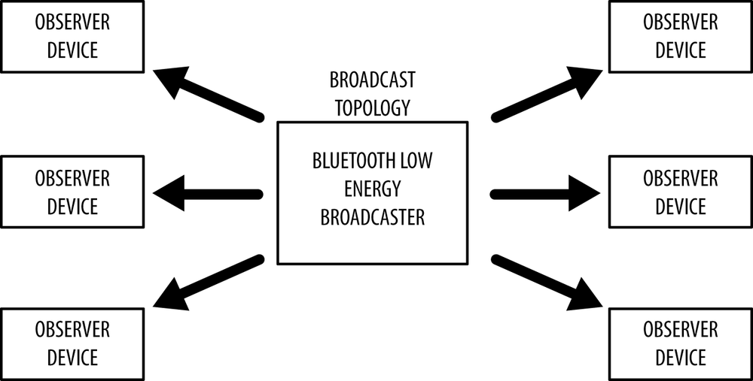
Bluetooth low energy
Broadcasting
As illustrated in Figure below, this mechanism essentially allows you to send data out one-way to anyone or anything that is capable of picking up the transmitted data.
Broadcasting defines two separate roles:
Broacaster : Sends packet periodically.
Observer : Repeatedly scans the frequencies to receive packets .
Notes:
Broacaster
Sends nonconnectable advertising packets periodically to anyone willing to receive them.
Observer
Repeatedly scans the preset frequencies to receive any nonconnectable advertising packets currently being broadcasted.

Slide 26
Bluetooth low energy
Connections involve two separate roles:
Central (master) :Repeatedly scans the preset frequencies for connectable advertising packets and, when suitable, initates a connection.Once the connection is established, the central manages the timing and initiates the periodical data exchanges.
Peripheral (slave) :A device that sends connectable advertising packets periodically and accepts incoming connections.Once in an active connection, the peripheral follows the central’s timing and exchanges data regularly with it.

Slide 27
Bluetooth low energy
Connections involve two separate roles:
To initiate a connection, a central device picks up the connectable advertising packets from a peripheral and then sends a request to the peripheral to establish an exclusive connection between the two devices.
Once the connection is established, the peripheral stops advertising and the two devices can begin exchanging data in both directions

Slide 28
Bluetooth low energy
Bluetooth Low Energy Technology is Completely New
In several key aspects, Bluetooth low energy technology is a totally new technology.
In other words, even if both technologies have a common name in “Bluetooth,” it is important to understand that the addition of Bluetooth low energy technology is not the same thing as when new versions of the Bluetooth Specification have been released in the past.

Slide 29
Bluetooth v4.0
Is It Worth Getting Excited?
Low energy usage, increased range, improvements in connectivity and the sheer number of devices that already feature Bluetooth 4.0 connectivity makes it an impossible technology to ignore.
As for what the future holds, we can only speculate; but we can tell you that Bluetooth could change the way we do just about everything on our mobile devices.

Slide 30
Bluetooth low energy
Bluetooth low energy (LE) (also called Bluetooth Smart or Version 4.0+ of the Bluetooth specification) is the power- and application-friendly version of Bluetooth that was built for the Internet of Things (IoT).

Slide 31
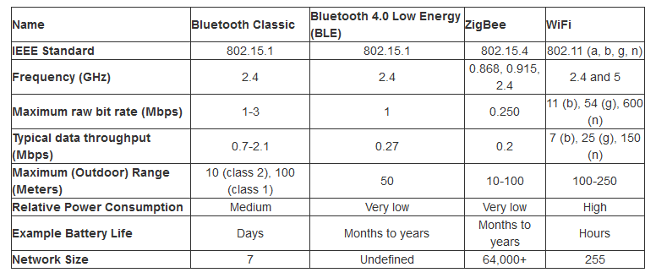
Bluetooth v4.0
picture source:https://learn.sparkfun.com/tutorials/bluetooth-basics

Slide 32
Overview(v4.1)
The Bluetooth SIG announced formal adoption of the Bluetooth v4.1 specification on 4 December 2013.
These include increased co-existence support for LTE, bulk data exchange rates.

Slide 33
Bluetooth v4.1
Bluetooth v4.1 feature
圖片來源：http://www.mem.com.tw/article_content.asp?sn=1406050004
Feature | Benefits
Mobile Wireless Service Coexistence Signaling | Engineered to work seamlessly with cellular technologies like LTE
Train Nudging and Generalized Interlaced Scanning
Low Duty Cycle Directed Advertising | Maintain connections with less frequent manual intervention
L2CAP Connection Oriented Channels | Exchange data more efficiently
Notes:
藍牙SIG官方資料(表1)指出，現階段藍牙4.1規格中的邏輯連結控制與調適協定連結(L2CAP Connection)專用通道，僅係為未來感測器對IPv6的支援所設計的基礎架構，而藍牙SIG仍在開發IPv6連線標準，以讓IPv6感測裝置在未來可以設定專用溝通通道與藍牙裝置連線。
除預留IPv6通道外，藍牙4.1標準也特別加入與蜂巢式(Cellular)通訊技術共存(Coexistence)的特色，可與長程演進計畫(LTE)無縫、和諧地運作，雙方可自動相互協調，以避免近頻帶干擾(Near-band Interference)；此外，藍牙4.1標準具備更短的工作週期(Duty Cycle)，能降低消費者手動調整藍牙裝置連結情形的次數。

Slide 34
1. Coexistence
Bluetooth and 4G (LTE) famously don’t get on: their signals interfere degrading one another’s performance and draining battery life.
Bluetooth 4.1 eliminates this by coordinating its radio with 4G automatically so there is no overlap and both can perform at their maximum potential.
Notes:
Coexistence：讓Bluetooth可以和LTE共存，自動協調兩者的傳輸訊息，透過錯開傳輸順序來降低臨近頻譜的干擾。
因為在實際的應用中，如果這兩者同時傳輸數據，那麼藍牙通信就可能受到手機網絡信號的干擾，導致傳輸速率的下降。因此在全新的藍牙4.1標準中，一旦遇到藍牙4.1和4G網絡同時在傳輸數據的情況，那麼藍牙4.1就會自動協調兩者的傳輸信息，從而減少其它信號對藍牙4.1的干擾。

Slide 35
2. Smart connectivity
Rather than carry a fixed timeout period, Bluetooth 4.1 will allow manufacturers to specify the reconnection timeout intervals for their devices.
This means devices can better manage their power and that of the device they are paired to by automatically powering up and down based on a bespoke power plan.
Notes:
更聰明的連線：對於管理和建立連線，有更多的控制。例如可以控制重建連線的間隔(Reconnection timeout interval)。有自動重連線之功能。

Slide 36
3. Improved Data Transfer
Bluetooth 4.1 devices can act as both hub and end point simultaneously.
This is hugely significant because it allows the host device to be cut out of the equation and for peripherals to communicate independently.
Notes:
改善資料傳輸：
1. BLE裝置可以當作hub或是endpoint使用。
2. 裝置間可以互相溝通，整合資料後，再批次的傳給主機。
3. Bulk data transfer，可以先把各種資料蒐集後再一次傳輸，增進效率。

Slide 37
3. Improved Data Transfer
For example, whereas previously a smartwatch would need to talk to your phone to get data from a heart monitor, now the smartwatch and heart monitor can talk directly saving your phone’s battery and then upload their compiled results directly to your phone.
This is crucial to the Internet of Things concept.

Slide 38
Overview(v4.2)
Bluetooth v4.2 was released on December 2, 2014.
It Introduces some key features for IoT.
Internet Protocol Support Profile(IPSP)
Notes:
藍牙 4.2 版本的主要目的，是讓 Bluetooth Smart 繼續成為連結生活中各種事物的最佳解決方案，範圍涵蓋個人感測器到連網家庭。除了規格本身的升級，藍牙 4.2 還支援 IPv6 藍牙應用的新網路協定支援定義（IPSP）。

Slide 39
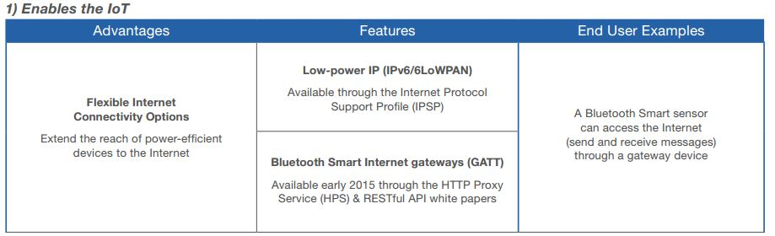
IoT Capabilities
Low-power IP (IPv6/6LoWPAN)
Bluetooth Smart Internet Gateways (GATT)
Notes:
和Internet相連接：
1. 利用Internet Protocol Support Profile(IPSP)，可以讓Bluetooth Smart直接存取Internet(IPv6/6LoWPAN)
2. 滿足暨需要PAN和WAN的裝置(如智慧家庭的Gateway角色)

Slide 40
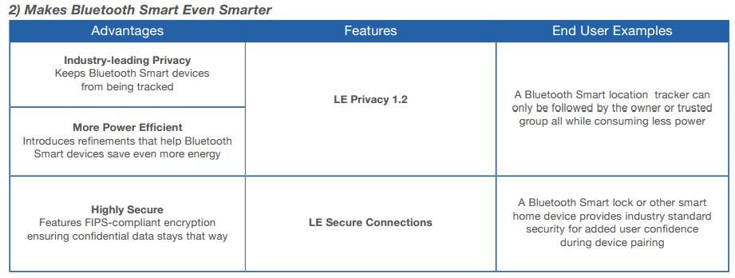
Security
LE Privacy 1.2
LE Secure Connections (Federal Information Processing Standard)

Slide 41
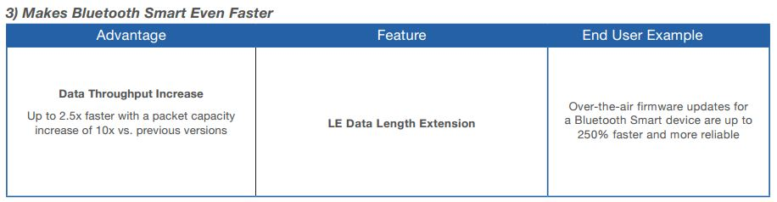
Speed
250% Faster
Data Packet Length Extension
Notes:
速度提升：
傳輸封包容量加大，可以達到比前一版快2.5倍的傳輸速度
降低傳輸錯誤機率，提升傳輸效率

Slide 42
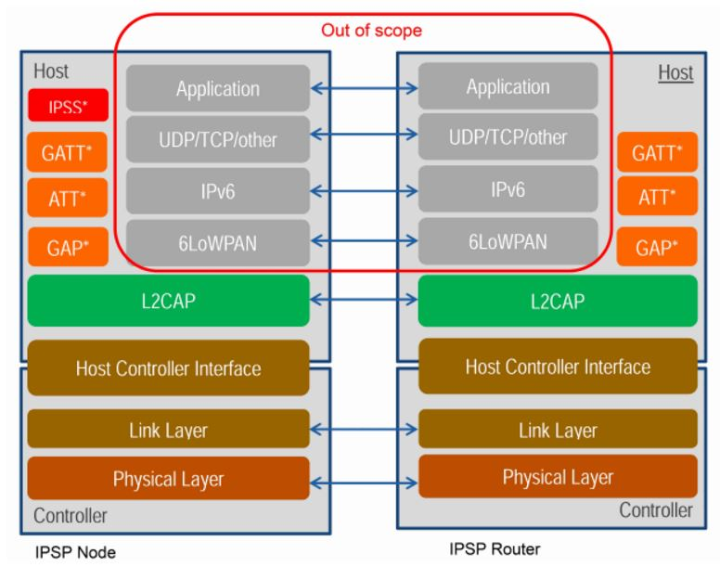
IPSP: Internet Protocol Support Profile
圖片來源 : http://www.wowotech.net/?post=278
Notes:
IPSP不同之處在於為設備製造商提供在其產品中支援非HTTP協定的方法，可透過藍牙支援6LoWPAN的路由器。藍牙技術聯盟考慮到物聯網產業發展有望帶動感測器和連接設備產量的大幅增長，因而寄望以IPv6提供更多的IP位址，打造更理想的藍牙技術協議。
上圖描述基於藍牙低功耗堆疊包含IPSP的IPv6。其中，使用者資料流通訊協定(UDP)和傳輸控制協議(TCP)僅是做為傳輸協議的舉例，但是該堆疊可被用於任何其他可運行於IPv6之上的上層協議。舉例來說，6LoWPAN層運行於藍牙低功耗L2CAP層(負責大於基礎射頻處理能力的資料包之分段和重組)之上，IPv6有賴於L2CAP 專用通道特性，意味著其運行需要藍牙4.1或更新版本。
在加入HPS、IPSP和RESTful API等技術規格後，藍牙4.2已成為一項兼容網路的技術。IPv6可建構物聯網的互通性，讓藍牙設備能輕鬆的進入智慧裝置的生態系統中，使用者可透過RESTful API和HTTP代理協定，從雲端連接Bluetooth Smart設備，使其成為最符合目的及市場定位的技術。

Slide 43
IPSS: Internet Protocol Support Service
ATT: Attribute Protocol
HPS: The HTTP Proxy Service
RESTful APIs allow the secure discovery, access and control of any Bluetooth Smart device using HTTP or HTTPS

Slide 44
ATT: Attribute Protocol
Attributes are the smallest data entity defined by GATT (and ATT).
They are addressable pieces of information that can contain relevant user data (or metadata) about the structure and grouping of the different attributes contained within the server.
Notes:
低功耗藍牙在與Classic BT共用的底層架構之上(L2CAP/HCI)，架構了以attribute為基礎的通訊架構(Attribute Protocol；ATT)，將設備間的通訊切割成以request/response為基礎的資料交換。

Slide 45
ATT: Attribute Protocol
The specification defines attributes only conceptually, and it does not force the ATT and GATT implementations to use a particular internal storage format or mechanism.
The sole building block of ATT is the attribute.
a 16-bit handle
an UUID which defines the attribute type;
a value of a certaing length.
Notes:
ATT (Attribute) : 所有BLE裝置都要支援ATT (Attribute, 屬性)協定。
是一個資料結構：
struct {
u16 uuid; // Universally Unique Identifier
u8 *data; // variable length data
} att[65536];
這個通訊協定就是一張表格，一個陣列。陣列允許random access，只要給個index就可以了。
在BLE的術語理，這個index叫handle。表格每個單元還包括16bit的UUID作為metadata，解釋這筆資料是什麼。另外資料並不是直接嵌在表格，而是放一個指標，允許可變長度的資料。

Slide 46
ATT - Handle
The attribute handle is a unique 16-bit identifier for each attribute on a particular GATT server. (GAP (Generic Attribute Profile)
It is the part of each attribute that makes it addressable, and it is guaranteed not to change (with the caveats described in Attribute Caching) between transactions or, for bonded devices, even across connections.

Slide 47
ATT - Type
The attribute type is nothing other than a UUID (see UUIDs).
This can be a 16-, 32-, or 128-bit UUID, taking up 2, 4, or 16 bytes, respectively.
The type determines the kind of data present in the value of the attribute, and mechanisms are available to discover attributes based exclusively on their type.

Slide 48
ATT - Value
There are no restrictions on the type of data it can contain (you can imagine it as a non-typed buffer that can be cast to whatever the actual type is, based on the attribute type), although its maximum length is limited to 512 bytes by the specification.
This is the part of an attribute that a client can freely access (with the proper permissions permitting) to both read and write.

Slide 49
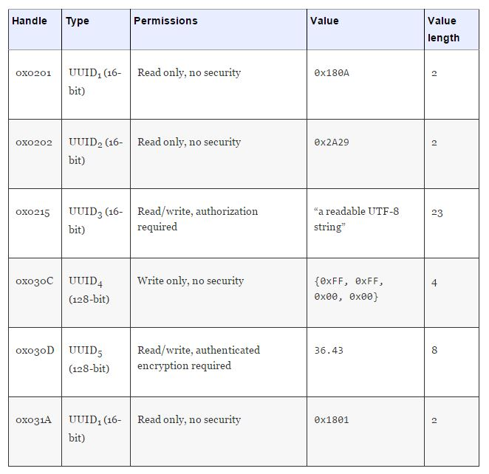
Attributes represented

Slide 50
GATT: Generic Attribute Profile
GATT is a base profile for all top-level LE profiles. It defines how a bunch of ATT attributes are grouped together into meaningful services.
This data is organized hierarchically in sections called services, which group conceptually related pieces of user data called characteristics.
Notes:
在ATT之上的是GATT(Generic Attribute Profile)，定義了基於ATT進行通訊的設備之間的主從關係(Central/Peripheral/Broadcaster/Observer)、服務探索方式以及各種數據讀寫模式等等。這也是開發者所能接觸到的最底層功能。
在GATT上，應用可以依據功能(Feature)將不同的數據群組以服務(Service)的方式發布出去，另外，針對不同需求、應用可以和一個或多個服務進行溝通，形成一個Profile。這部分在Classic BT和低功耗藍牙之間的定義是不同的。BluetoothSIG針對常用的功能已經定義了相當數量的Service/Profile，如心跳計、體溫計等，但開發者依然可以依照自己的需求在GATT之上發揮。
Generic Attribute Profile：具體實現數據的傳輸(GATT)。 Server上所有的ATT都被實作了，成為一個個的Services，通過這樣的形式把數據包給Client。把ATT定義的屬性根據不同的服務進行 歸類、組合，同時把一系列的讀寫整合起來，成為一系列的數據通信操作流程，提供給上層的Profile去用。

Slide 51
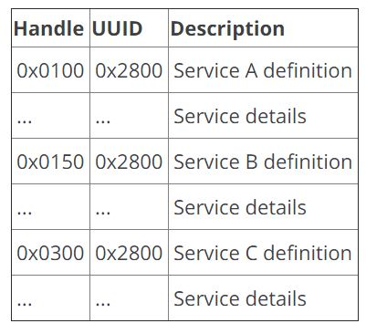
GATT: Generic Attribute Profile
For example, a device with three services might have the attribute layout:

Slide 52
GATT: Generic Attribute Profile
A universally unique identifier (UUID) is a 128-bit (16 bytes) number that is guaranteed (or has a high probability) to be globally unique.
For efficiency, and because 16 bytes would take a large chunk of the 27-byte data payload length of the Link Layer, the BLE specification adds two additional UUID formats: 16-bit and 32-bit UUIDs.

Slide 53
GATT - Client
It sends requests to a server and receives responses (and server-initiated updates) from it.
The GATT client does not know anything in advance about the server’s attributes, so it must first inquire about the presence and nature of those attributes by performing service discovery.
After completing service discovery, it can then start reading and writing attributes found in the server, as well as receiving server-initiated updates.

Slide 54
GATT - Server
It receives requests from a client and sends responses back.
It also sends server-initiated updates when configured to do so, and it is the role responsible for storing and making the user data available to the client, organized in attributes.
Every BLE device sold must include at least a basic GATT server that can respond to client requests, even if only to return an error response.

Slide 55
IPSS(Internet Protocol Support Service)
A device supporting the Node role shall implement the GATT server role and instantiate one and only one IP Support Service (IPSS).
Notes:
IPSS（Internet Protocol Support Service）提供了一个名稱為IP Suppot Service UUID（0x1820）的GATT service，用於服務表現。

Slide 56
GAP: Generic Access profile
Assigned numbers are used in GAP for inquiry response, EIR (Extended Inquiry Response) data type values, manufacturer-specific data, advertising data, low energy UUIDs and appearance characteristics, and class of device.
GAP is what makes your device visible to the outside world and determines how two devices can (or can't) interact with each other.
Notes:
設備查找、連接建立(GAP)，定義了四個角色。該Profile保證不同的Bluetooth產品可以互相發現對方並建立連接。
Peripheral和Central：兩個設備連接後，進行通訊的角色。Peripheral通常是連接外面的設備(從設備)，例如說血壓計等等。而Central則是連接主設備，例如手機、電腦等等。Peripheral通常是ATT及GATT的Client，Central通常是ATT及GATT的Server。
Broadcaster和Observer：兩個設備在不見連接的時後，進行通訊的角色。Broadcaster會通過一個簡單的設備，不斷的把數據丟出去，例如一個單純的溫度計。Observer則接收這些封包把相應的溫度值儲存起來。

Slide 57
GAP: Generic Access profile
GAP defines various roles for devices.
Peripheral devices are small, low power, resource contrained devices that can connect to a much more powerful central device. Peripheral devices are things like a heart rate monitor, a BLE enabled proximity tag, etc.
Central devices are usually the mobile phone or tablet that you connect to with far more processing power and memory.

Slide 58
GAP: Generic Access profile
There are two ways to send advertising out with GAP: the Advertising Data payload and the Scan Response payload.
Both payloads are identical and can contain up to 31 bytes of data, but only the advertising data payload is mandatory, since this is the payload that will be constantly transmitted out from the device to let central devices in range know that it exists.
Notes:
There are two ways to send advertising out with GAP. The Advertising Data payload and the Scan Response payload.

Slide 59
GAP: Generic Access profile
The scan response payload is an optional secondary payload that central devices can request, and allows device designers to fit a bit more information in the advertising payload such as strings for a device name, etc.

Slide 60
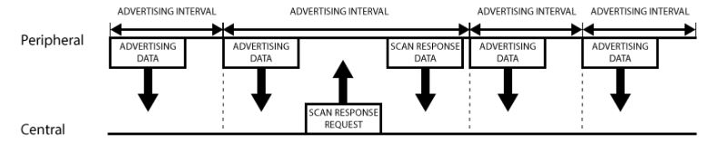
GAP: Generic Access profile
Advertising Process
圖片來源:https://learn.adafruit.com/introduction-to-bluetooth-low-energy/gap
Notes:
A peripheral will set a specific advertising interval, and every time this interval passes, it will retransmit it's main advertising packet. A longer delays saves power but feels less responsive if the device only advertises itself once every 2 seconds instead of every 20ms.
If a listening device is interested in the scan response payload (and it is available on the peripheral) it can optionally request the scan response payload, and the peripheral will respond with the additional data.

Slide 61
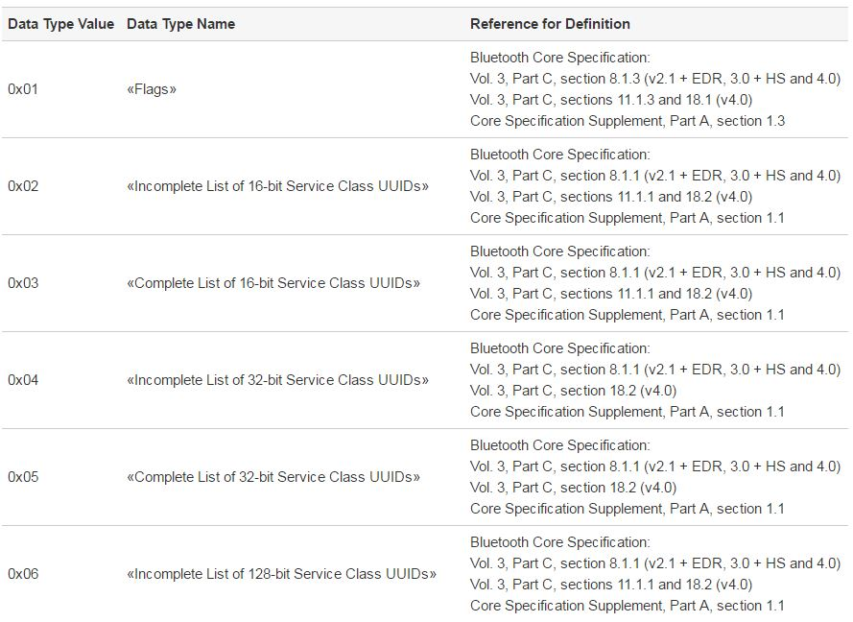
GAP: Generic Access profile
Notes:
這裡只列出0x01~0x06和0x19~0xFF

Slide 62
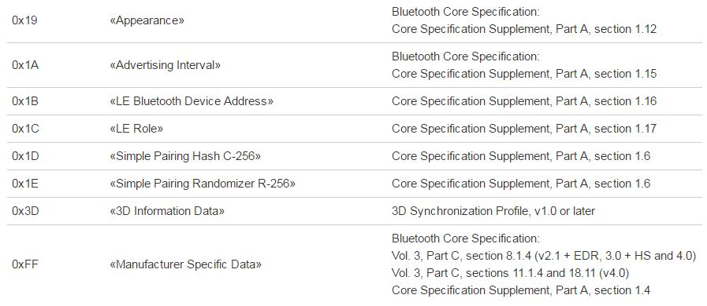
GAP: Generic Access profile
More information(0x07~0x18): https://www.bluetooth.org/en-us/specification/assigned-numbers/generic-access-profile

Slide 63
HPS (HTTP Proxy Service )
The HTTP Proxy Service (HPS) allows a device to expose HTTP Web services to a client of the HPS Server (HPS Client) using the Generic Attribute Profile (GATT).
This enables an HPS Client device to program a set of characteristics that configures a Hyper Text Transfer Protocol (HTTP) request, initiate this request, and then read the response.

Slide 64
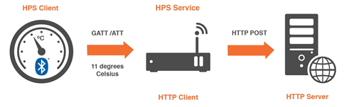
HPS - Example
For example, you could have temperature sensors positioned all around your Smart Home reporting temperature readings to a cloud-based energy efficiency service.

Slide 65
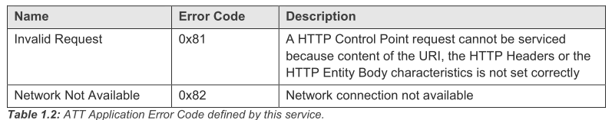
HPS - Error Codes
This service defines the following Attribute Protocol (ATT) Application error code:

Slide 66
HPS - Service Characteristics
The following characteristics are exposed in the HTTP Proxy Service. Only one instance of each characteristic is permitted within this service.
The characteristic formats and UUIDs are same as Generic Access profile (p55,p56).

Slide 67
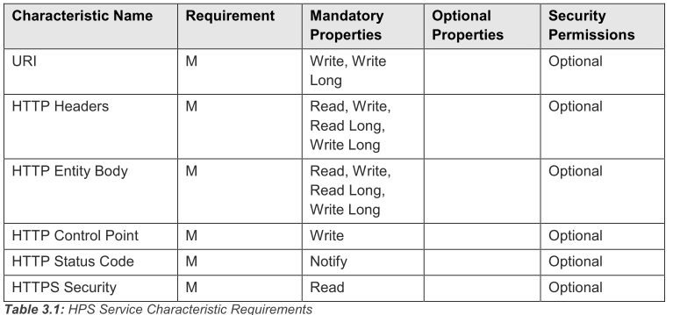
HPS - Service Characteristics
The letter “M” (Mandatory) indicates that it is mandatory to claim support.
Notes:
URI(Uniform Resource Identifier)
統一資源識別元（Uniform Resource Identifier，或URI)是一個用於標識某一網際網路資源名稱的字串。 該種標識允許用戶對網路中（一般指全球資訊網）的資源通過特定的協定進行互動操作。URI的最常見的形式是統一資源定位符（URL），經常指定為非正式的網址。

Slide 68
HPS - URI Characteristic
The URI characteristic is used to configure the URI for a subsequent request.
The URI characteristic shall contain the URI to be used in the HTTP request as a UTF-8 string (utf8s), up to the maximum characteristic length defined.
This version of the specification supports HTTP requests with URI up to 512 octets in length.

Slide 69
HPS - HTTP Headers Characteristic
The HTTP Headers characteristic is used to hold the headers that would be sent with the HTTP Request or the headers contained within an HTTP response message from the HTTP Server.
This version of the specification supports HTTP requests with HTTP headers up to 512 octets in length.

Slide 70
HPS - HTTP Entity Body Characteristic
The HTTP Entity Body characteristic contains the contents of the message-body after any Transfer-Encoding has been applied.
For HTTP requests that do not send an HTTP Entity Body, the HPS Server shall expect client to initialize it with a zero-length value.
This version of the specification supports HTTP requests with HTTP Entity Body up to 512 octets in length.

Slide 71
HPS - HTTP Control Point Characteristic
The HTTP Control Point is used to initiate a request to send an HTTP request message from the device containing the HTTP Proxy Service, acting as an HTTP Client.
The HTTP Control Point characteristic is one octet long (unit8) and identifies the HTTP request type.

Slide 72
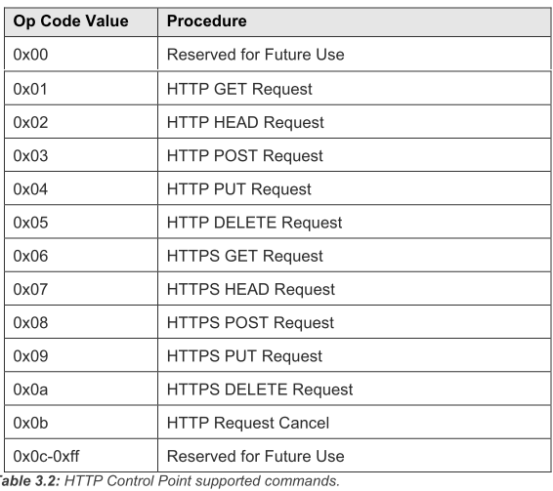
HPS - HTTP Control Point Characteristic

Slide 73
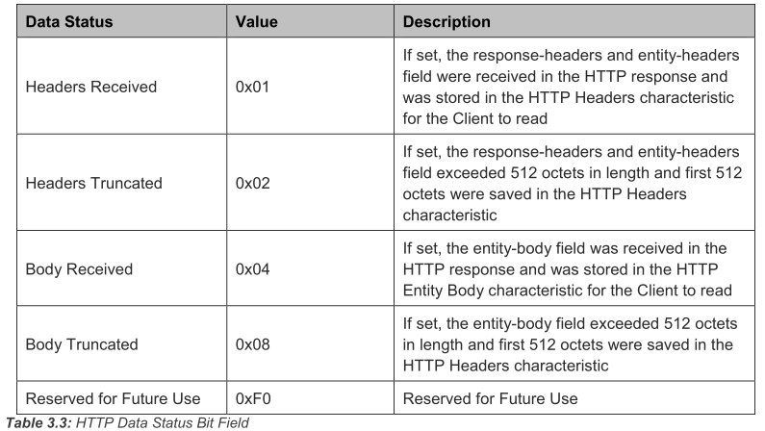
HPS - HTTP Status Code Characteristic
The HTTP Status Code characteristic contains the Status-Code from the Status-Line of the first line of the HTTP Response message.

Slide 74
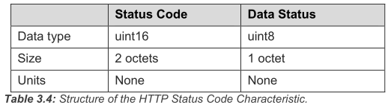
HPS - HTTP Status Code Characteristic
The HTTP Status Code characteristic value is 3 octets in length with first two-octets representing the Status Code encoded as uint16 based on the HTTP Status Code followed by 1 octet Data Status bit field.
The structure of the HTTP Status Code characteristic is defined below:

Slide 75
HPS - Connection Procedure
The HPS Server shall support at least one of the GAP(Generic Access Profile) Connectable modes.
The HPS Server may allow connections from any HPS Client or from previously bonded HPS Clients only. The HPS Server shall perform one of the GAP Connection Establishment procedures to the HPS Clients.

Slide 76
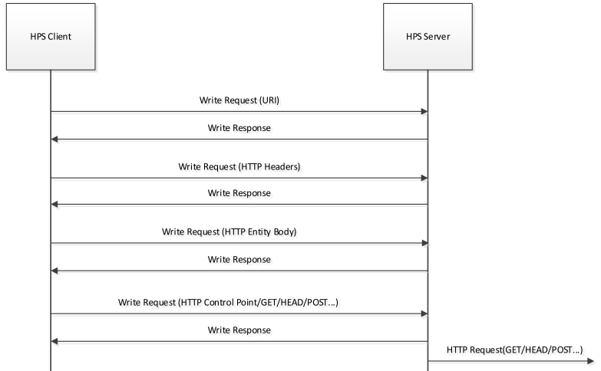
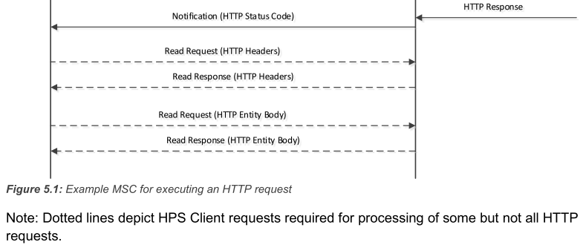
HPS - The GATT exchange

Slide 77
RESTful API
This API can be used to administrate connections to devices equipped with Bluetooth low energy technology.
This REST API defines how GAP(Generic Access Profile) resources are accessible using the standard HTTP methods (GET=Read and PUT=Write).

Slide 78
RESTful API - Remarks
Stateless
A RESTful API is stateless which means that the gateway is not required to memorize any state for its client applications.
This also means that several Web clients may access the same resources in parallel.

Slide 79
RESTful API - Remarks
GAP Role
The REST API shall only handle a gateway operating in the GAP Central and Observer roles.
Security
If Hypertext Transfer Protocol Secure (HTTPS) is used, the GAP API shall cause Bluetooth encryption for products equipped with Bluetooth wireless technology to be used on the Bluetooth link.
Bluetooth link encryption is not required if HTTP is used.
Notes:
The Observer is the opposite of the Broadcaster: it passively listens to BLE devices in its area and processes the data from the advertising packets it receives. It does not need a transmitter, as it sends nothing and is never meant to enter a connection.

Slide 80
RESTful API - Remarks
Enabled Nodes
The nodes that are to be connected and reconnected automatically are called enabled nodes.
It is assumed that the gateway is responsible for the connections between all enabled nodes and the gateway and will continuously try to establish a connection for all enabled nodes when possible.

Slide 81
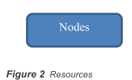
RESTful API - Definitions for the Resources
General
Individual nodes are identified by a handle called <node>.

Slide 82
RESTful API - Definitions for the Resources (Request - discover nodes and list enabled nodes)
GET http://<gateway>/gap/nodes?passive=1
The gateway will perform passive scan for nodes. Used scan parameters are decided by the gateway.
GET http://<gateway>/gap/nodes?active=1
The gateway will perform active scan for nodes. Used scan parameters are decided by the gateway.

Slide 83
RESTful API - Definitions for the Resources (Request - discover nodes and list enabled nodes)
GET http://<gateway>/gap/nodes?enable=1
The gateway will return a list of enabled devices (devices that are either connected or will be connected when available and at gateway power-up).
GET http://<gateway>/gap/nodes/<node>
The gateway will return data for an enabled node identified by the handle <node>.

Slide 84
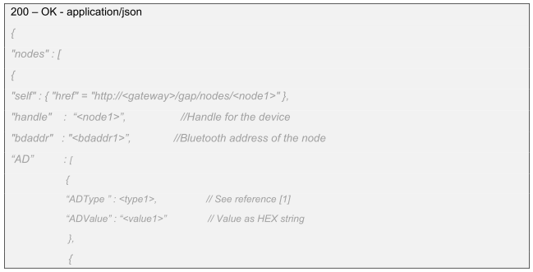
RESTful API - Definitions for the Resources (Responses - discover nodes and list enabled nodes)
Notes:
AD :Advertising Data Type

Slide 85
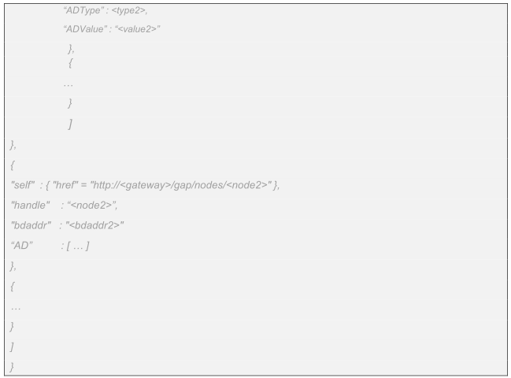
RESTful API - Definitions for the Resources (Responses - discover nodes and list enabled nodes)
Notes:
AD :Advertising Data Type

Slide 86
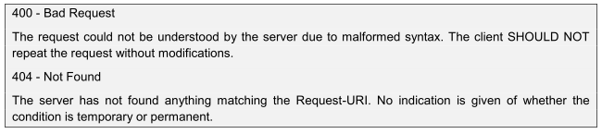
RESTful API - Definitions for the Resources (Responses - discover nodes and list enabled nodes)
Notes:
AD :Advertising Data Type

Slide 87
RESTful API - Definitions for the Resources (Requests - enabling and disabling of nodes)
PUT http://<gateway>/gap/nodes/<node>?connect=1(&interval=<interval>&latency=<latency>&enable=1)
Enable and connect to the node identified by <node>. The gateway will try to use the connection interval <interval> and the connection latency <latency>.
PUT http://<gateway>/gap/nodes/<node>?enable=0
Remove the node <node> from the list of enabled nodes.

Slide 88
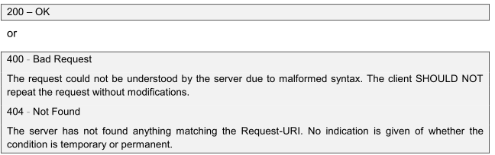
RESTful API - Definitions for the Resources (Responses - enabling and disabling of nodes)

Slide 89
RESTful API - Definitions for the Resources (Requests - enabling and disabling of nodes)
General Error Returns
These are general error return codes that may be returned for any of the API methods specified above and that not are listed for the individual method.

Slide 90
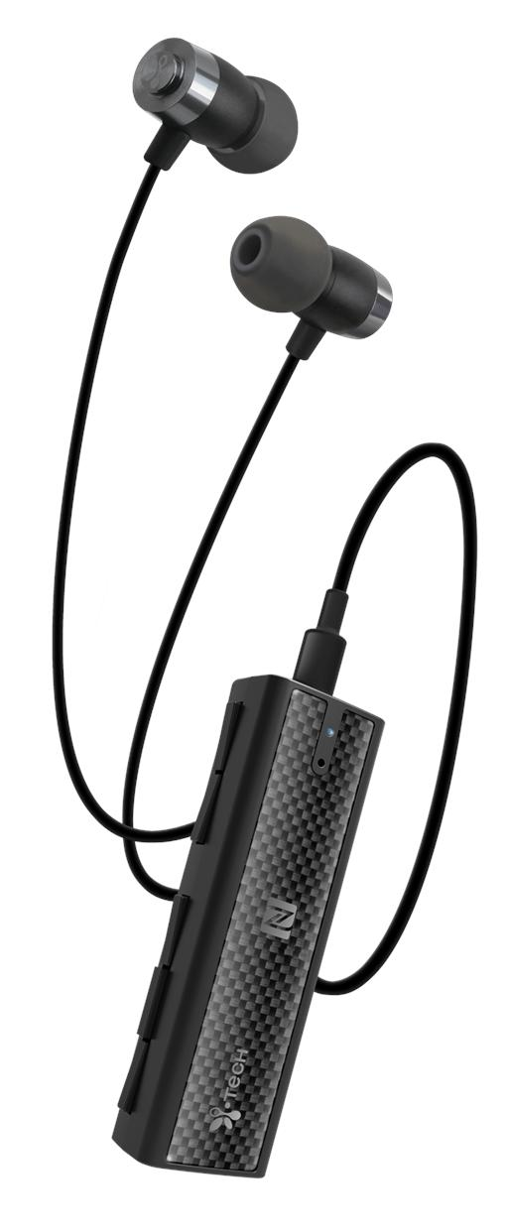
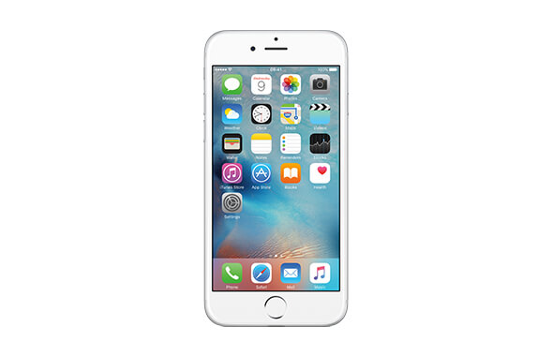
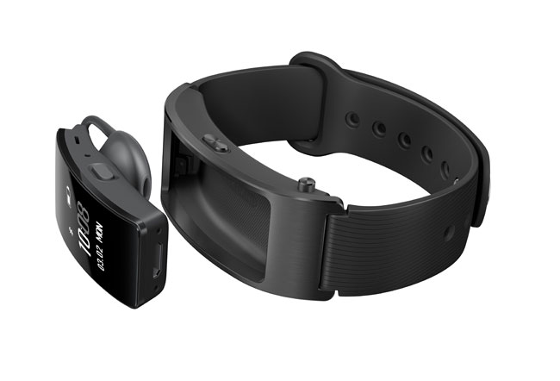
Application
HUAWEI TalkBand B3
Apple iPhone6
MusicClip 9100

Slide 91
Overview(v5.0)
The Bluetooth Special Interest Group (SIG) announced that its next release, coming late 2016 to early 2017, will be called Bluetooth 5.
Extending range will deliver robust, reliable Internet of Things (IoT) connections that make full-home and building and outdoor use cases a reality.

Slide 92
Bluetooth v5.0
Higher speeds will send data faster and optimize responsiveness.
Increasing broadcast capacity will propel the next generation of “connectionless” services like beacons and location-relevant information and navigation.
Bluetooth 5, will quadruple range and double speed of low energy connections while increasing the capacity of connectionless data broadcasts by 800 percent.

Slide 93
Bluetooth v5.0
One of the major features in Bluetooth 5 is a new 2 Mbps PHY.
Bluetooth 4.x devices only support a single 1 Mbps PHY rate, but Bluetooth 5 devices can support either the 1 Mbps or 2 Mbps PHY rates.
By doubling the PHY rate, the amount of data that devices can transfer is almost doubled.

Slide 94
Bluetooth v5.0
Another benefit of the faster PHY is the reduced time required for transmitting and receiving data, which translates to a lower average current consumption.
Bluetooth 5 devices supporting 2 Mbps PHY are still fully backwards compatible with Bluetooth 4 devices and will use the 1 Mbps PHY to communicate with devices that do not support the new 2 Mbps PHY.

Slide 95
A Choice of Three PHYs
The PHYsical Layer
Bluetooth 5 adds two new PHY variants to the PHY specification used in Bluetooth 4.
The three PHYs have been named to allow them to be easily referenced in specifications. (LE 1M, LE 2M, and LE Coded.)

Slide 96
LE 1M
LE 1M is the PHY used in Bluetooth 4.
It uses Gaussian Frequency Shift Keying and has a symbol rate of 1 mega symbol per second (Ms/s).
It continues to be available for use in Bluetooth 5 and its support is mandatory.

Slide 97
LE 2M
The new LE 2M PHY allows the physical layer to operate at 2 Ms/s
Enables higher data rates than LE 1M and Bluetooth 4.
The LE 2M PHY is characterized by using double the symbol rate that the LE 1M PHY uses and therefore double that of the Bluetooth 4 PHY.

Slide 98
LE 2M
2-level Gaussian Frequency Shift Keying (GFSK) continues to be used with binary zero represented by decreasing the carrier frequency by a given frequency deviation and a binary one represented by increasing the carrier frequency by the same deviation.

Slide 99
LE 2M
Comparison of 1M and 2M Bluetooth low energy PHYs
PHY | Symbol rate | Error detection | Range multiplier (approximate) | PDU Length | Minimum packet time | Maximum packet time | Maximum throughput
1M | 1 M symbols/s | CRC | 1 x | 0 - 257 B | 80 µs | 2.12 ms | 800 kbps
2M | 1 M symbols/s | CRC | 0.8 x | 0 - 257 B | 44 µs | 1.064 ms | 1438 kbps

Slide 100
The LE Coded PHY
The LE Coded PHY allows range to be quadrupled (approximately) compared to Bluetooth 4, and this has been accomplished without increasing the transmission power required.
The LE Coded PHYs use the 1M PHY rate, but the actual payload is coded either with 500 kbps (S=2) or 125 kbps (S=8) rate, whereas the preamble and access address use the 1M coding.

Slide 101
The LE Coded PHY
LE Coded PHY’s also use a slightly different packet format versus the 1M and 2M PHYs. A Coding Indicator (CI) and TERM1 and TERM2 headers are added into the LE packet.

Slide 102
The LE Coded PHY
Bluetooth 5 un-coded vs. coded PHY packet format
80 µs
256 µs
N * 8 µs
24 µs
LE Uncoded
PHY
Preamble
Access Address
PDU N Bytes
CRC
80 µs
256 µs
16 µs
24 µs
N * 8 * S µs
24 * S µs
3 * S µs
LE Coded
PHY
Preamble
Access Address
CI
TERM1
PDU N Bytes
CRC
TERM2
FEC Block 1
FEC Block 2
S = 8 Coding
S = 2 or S = 8 Coding

Slide 103
The LE Coded PHY
Using the coded PHYs improves the RX sensitivity, which also means improved range.
Typically, a 4-6 dB RX sensitivity improvement can be achieved using either the 500 kbps or 125 kbps PHY and this usually converts to a 2-4x range improvement.
The downside of the LE Coded PHY
Longer TX and RX times, which increases the average power consumption.

Slide 104
The LE Coded PHY
Comparison of LE Coded PHY’s
LE Coded PHY | Symbol rate | Error detection | Error correction | Range multiplier (approximate) | PDU Length | Minimum packet time | Maximum packet time | Maximum throughput
500 kbps S=2 | 1 M symbols/s | CRC | FEC | 2 | 0 - 257 B | 720 µs | 17040 ms | 382 kbps
125 kbps S=8 | 1 M symbols/s | CRC | FEC | 4 | 0 - 257 B | 462 µs | 4542 ms | 112 kbps

Slide 105
The LE Coded PHY
The LE Coded PHY allows range to be quadrupled (approximately) compared to Bluetooth 4, and this has been accomplished without increasing the transmission power required.
Error Detection and Error Correction
Bluetooth LE at version 4 does not perform error correction, only error detection.

Slide 106
The LE Coded PHY
Error Detection
Bluetooth uses a type of checksum known as a Cyclic Redundancy Check (CRC).
All packets have a 24-bit CRC value calculated for them by the transmitter and appended to the packet. The receiver recalculates the CRC and compares the calculated value with the value appended to the packet. If they are not the same, an error has occurred.

Slide 107
The LE Coded PHY
LE Coded PHYs also change the bit stream processing for TX and RX operations and add two steps into the packet transmissions and reception.
Forward error correction is applied to the packet so that the receiver has a capability to correct bit errors upon reception of the packet and improve packet error rate.
A pattern mapper is applied to the packet to improve the efficiency of the communications.

Slide 108
The LE Coded PHY
The figure below shows the new bit stream PDU processing sequence.
coding
TX payload
Encryption
CRC
Generation
Whitening
FEC
Encoding
Pattern
mapper
LSB first
RF interface
RX payload
Decryption
CRC
Checking
Dewhitening
FEC
Decoding
Pattern
de-mapper
decoding

Slide 109
The LE Coded PHY
The FEC block converts each input bit to two output bits by convolutional error correction encoder as shown below, which means the number of bits transmitted is duplicated when FEC is applied to the packet.
Input bit:
Output bits:
Notes:
The Convolutional FEC Encoder生成多項式如下： G0(x) = 1 + x + x2 + x3 G1(x) = 1 + x2 + x3
傳送順序為G0->G1
FEC Encoder在初始狀態為0，三個連續的0序列會讓FEC encoder回到原始的狀態，該序列被稱為Termination Sequence。
下圖說明了FEC encoder 的操作。每個輸入位元會轉換為兩個輸入位元，這意味著Packet使用FEC時，傳輸的位元數將會增加。
下圖為傳輸”011”的FEC Encoder轉換的狀態，最後的packet會變成”001101”

Slide 110
The LE Coded PHY
LE Coded may be used with a choice of 2 different coding schemes, termed S = 2 and S = 8.
The Pattern Mapper converts each bit from the convolutional FEC encoder into P symbols, where the value of P depends on the coding scheme in use.
If S = 2 then, there is no change (i.e. P = 1), but if S = 8 then each bit from the FEC encoder produces 4 output bits (i.e. P = 4) from the Pattern Mapper.

Slide 111
The LE Coded PHY
Pattern Mapper output options
Input bit from the convolutional FEC encoder | Output sequence when P = 1 (used by S = 2) | Output sequence when P = 4 (used by S = 8)
0 | 0 | 0011
1 | 1 | 1100

Slide 112
The LE Coded PHY
Given a sequence “00110101” generated from the FEC encoder.
P = 1 (S = 2)
00110101
Sequence remain unchanged.
P = 4 (S = 8)
0011 0011 1100 1100 0011 1100 1100 1100 1100
Notes:
當FEC Encoder 產生出 “00110101” Sequence，若 P = 1(S = 2)時Sequence 維持不變 ”00110101”；當P = 4時變為 ”0011 0011 1100 1100 0011 1100 1100 1100 1100” 使用S=2時，無線傳輸範圍大約會增加為二倍， S=8時則為四倍。FEC演算法所要求的額外位元會對有效負載產生負擔，這是增加傳輸範圍的缺點。

Slide 113
The LE Coded PHY
The choice of coding scheme, S = 2 or S = 8, with the LE Coded PHY has two consequences.
With S = 2, range will be approximately doubled.
With S = 8, range will be approximately quadrupled.
Due to the requirement for redundant data to support the FEC algorithm at the receiver, it also impacts the number of symbols which must be transmitted. This reduces the overall data rate.
Notes:
FEC演算法所要求的額外位元會對有效負載產生負擔，這是增加傳輸範圍的缺點。

Slide 114
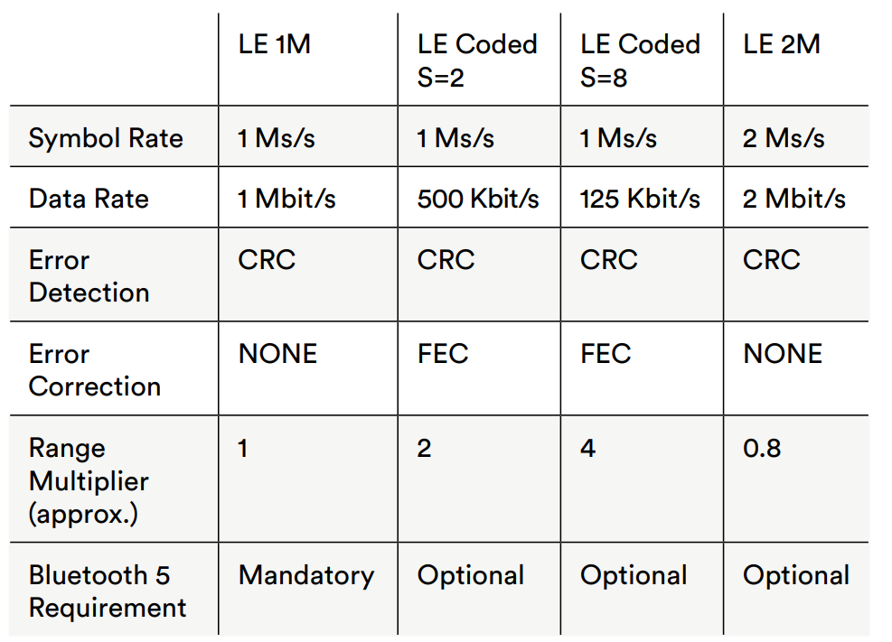
Comparing the Three PHYs

Slide 115
Advertising Extensions
Bluetooth 5 allows packets to be up to 255 octets long.
Offloading the payload to one of the other channels in the 0-36 channel number range, previously only used for connection events
Only header data, including a new field called AuxPtr, is transmitted on channels 37, 38, and 39, which are now known as the Primary Channels in the context of Bluetooth 5 advertising.

Slide 116
Advertising Extensions
Advertising channels in Bluetooth 4 vs Bluetooth 5
Bluetooth version | Advertising Channel | Payload | PHY
Bluetooth 4 | 3 | 0 – 31 B | LE 1M
Bluetooth 5 | 3 Primary 37 Secondary | 0 – 31 B (Primary) 0 – 255 B (Secondary) | LE 1M, LE Coded (Primary) LE 1M, LE 2M, LE Coded (Secondary)

Slide 117
Advertising Extensions
Legacy advertising
37 Bytes
Advertising channels
(37, 38, 39)
Advertising
Data payload
Advertising
Data payload
Advertising
Data payload
Advertising header
Advertising extensions
Primary channels
(37, 38, 39)
Advertising
Data payload
Secondary channels
(0 to 36)
255 Bytes

Slide 118
Advertising Packet Chaining
It’s possible to chain packets together and for each packet to contain a different subset of the whole data set.
Each chained packet can be transmitted on a different channel, with the AuxPtr header field referencing the next in the chain.
Up to 1650 Bytes for a chain
………
Header
Data payload
Header
Data payload
Header
Data payload

Slide 119
Secondary Advertising Packet
In addition to the new advertisement channels, Bluetooth 5 also introduces a new advertisement packet type called ADV_EXT_IND.
This packet can be sent on the primary advertisement channels and it indicates additional data will be available through a secondary advertisement.
Contains information about the secondary advertisement such as on which channel the advertisement occurs, when it occurs, and which Bluetooth PHY will be used.

Slide 120
Secondary Advertising Packet
Advertising event using the ADV_EXT_IND PDUs and AUX_ADV_IND PDU containing advertising data
ADV_EXT_IND
ADV_EXT_IND
ADV_EXT_IND
≦ 10 ms
≦ 10 ms
AUX_ADV_IND
Adv_idx=37
Adv_idx=38
Adv_idx=39
≧ T_MAFS
SAdv_idx=(x)
Advertising Event and
Extended Advertising Event started
Advertising Event closed
Extended Advertising Event closed

Slide 121
Secondary Advertising Packet
In case the advertiser wants to send more data than a single AUX_ADV_IND packet can contain; it is possible to chain multiple secondary advertisements using the AUX_CHAIN_IND packet.
AUX_CHAIN_IND packets can also contain pointers to additional AUX_CHAIN_IND packets in order to transmit advertisement payloads beyond 255 bytes.

Slide 122
Secondary Advertising Packet
Providing additional advertisement data using AUX_CHAIN_IND
ADV_EXT_IND
ADV_EXT_IND
ADV_EXT_IND
≦ 10 ms
≦ 10 ms
≧ T_MAFS
≧ T_MAFS
AUX_ADV_IND
AUX_CHAIN_IND
Adv_idx=37
Adv_idx=38
Adv_idx=39
Advertising Event closed
SAdv_idx=(x)
SAdv_idx=(y)
Advertising Event and
Extended Advertising Event started
Extended Advertising Event closed

Slide 123
Periodic Advertising
Bluetooth 5 introduces the ability to perform periodic and deterministic advertising, which allows scanners to synchronize their scanning for packets with the schedule of the advertising device.
This can be a more power-efficient way to perform scanning
New uses of Bluetooth LE in connectionless scenarios.

Slide 124
Periodic Advertising
Periodic advertising enables the advertiser to send out changing advertisement data periodically and with a fixed interval, and one or multiple scanners can listen to it.
Periodic advertisement mode is indicated with the ADV_EXT_IND packets, which point to AUX_ADV_IND packet (interval, hopping sequence, advertiser address etc.)

Slide 125
Periodic Advertising
The advertiser will also send AUX_SYNC_IND packets at the identified interval containing the actual periodic advertisement data.
The advertiser will periodically send new ADV_EXT_IND packets, so that new scanners can synchronize to the data stream or existing scanners can resume a lost sync.

Slide 126
Periodic Advertising
ADV_EXT_IND
ADV_EXT_IND
ADV_EXT_IND
ADV_EXT_IND
T_advEvent
≦ 10 ms
≦ 10 ms
Adv_idx=37
……
AUX_ADV_IND
AUX_SYNC_IND
Adv_idx=37
Adv_idx=38
Adv_idx=39
≧ T_MAFS
SAdv_idx=(x)
SAdv_idx=f(y)
Next AUX_SYNC_IND
Periodic
Advertising
Interval

Slide 127
Reduced Contention and Duty Cycle
Radio channels are now used:
Primary advertising channels 37, 38, and 39 carrying less data.
Secondary channels 0-36 doing most of the heavy lifting.
With advertising data using all available channels, and only small headers using the primary channels, there will be less contention on those channels.

Slide 128
Reduced Contention and Duty Cycle
Bluetooth 5 now transmits the payload once only, with small headers referencing it from the primary channels.
The total amount of data transmitted is thus less and so duty cycle has been reduced.
Advertising
Data payload
Advertising
Data payload
Advertising
Data payload
Bluetooth 4 repeating the payload on channel 37, 38, 39
Header and overhead
Bluetooth 5 transmitting the payload once only on a secondary channel
Advertising
Data payload

Slide 129
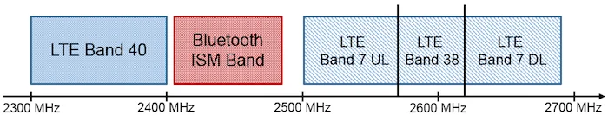
Slot Availability Masks
Slot Availability Masks enables Bluetooth devices to indicate to each other which time slots are available for receiving and transmitting.
By marking slots as unavailable during LTE activity, LTE interoperability is improved.

Slide 130
Slot Availability Masks
From the baseband point of view, SAM provides a “SAM slot map” which marks the availability of Bluetooth slots.
The availability arises from either external conditions (e.g., MWS coexistence) or internal conditions (e.g., topology management for scatter nets).

Slide 131
Slot Availability Masks
Slot Availability Masks (SAM) slot types.
Slot type code | Meaning
0 | The slot is not available for either transmission or reception
1 | The slot is available for transmission but not reception
2 | The slot is available for reception but not transmission
3 | The slot is available for both transmission or reception

Slide 132
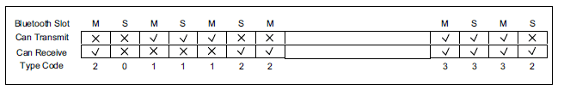
Slot Availability Masks
The figure below shows an example of a SAM slot map.
The master-to-slave slots are labeled with the letter ‘M’ and slave-to-master slots with the letter ‘S’.

Slide 133
Improved Frequency Hopping
Hopping sequences are now pseudo random and the distinct sequences which are possible are very large.
Devices can indicate in connection parameters whether they support the new channel selection algorithm.
Channel selection algorithm makes use of a shared event counter, which ensures that each peer in the connection selects the same channel from the next available channel in a pseudo-random sequence.

Slide 134
The Significance of Bluetooth 5
Whole-home and building coverage is provided of long-range LE Coded PHY.
The higher symbol rate of LE 2M.
Advertising extensions feature will pave the way for next-generation beacons.
Bluetooth 5 will have a substantial impact in many sectors and further position it as the low power wireless technology of choice for the Internet of Things.

Slide 135
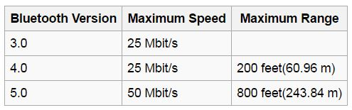
Conclude
Bluetooth v3.0, v4.0, v5.0

Slide 136
Rerfrence
wikipedia:https://en.wikipedia.org/wiki/Bluetooth#Bluetooth_v3.0_.2B_HS
Buzzle bluetooth v3.0:http://www.buzzle.com/articles/bluetooth4-vs-bluetooth3hs.html
GIZMOD:http://gizmodo.com/5232940/giz-explains-everything-bluetooth-and-why-bluetooth-30-is-better
why dual mode make sense:https://www.ecnmag.com/article/2013/01/why-dual-mode-bluetooth-makes-sense
safari:https://www.safaribooksonline.com/library/view/getting-started-with/9781491900550/ch01.html
Bluetooth:https://www.bluetooth.com/
MUO:http://www.makeuseof.com/tag/how-bluetooth-4-0-is-shaping-the-future-of-mobile-connectivity/
GATT:https://www.safaribooksonline.com/library/view/getting-started-with/9781491900550/ch04.html
Bluetooth low energy:http://shyuanliang.blogspot.tw/2014_10_01_archive.html
General introduction: https://zh-tw.coursera.org/learn/wireless-communication-technologies/lecture/xbvzP/bluetooth
Bluetooth 4.1: http://www.trustedreviews.com/opinions/bluetooth-4-1-what-is-it-and-why-should-you-care
Bluetooth 4.2: http://www.newelectronics.co.uk/electronics-technology/connecting-to-the-internet-just-got-even-easier-says-the-bluetooth-sig/73741/
Bluetooth 5.0: https://www.bluetooth.com/specifications/bluetooth-core-specification/
LE coded PHY: https://www.silabs.com/whitepapers/bluetooth-5-refined-for-the-iot
FEC: https://www.dazhuanlan.com/2019/10/17/5da86ae93184b/
Phase Shift Keying: https://en.wikipedia.org/wiki/Phase-shift_keying#Offset_QPSK_.28OQPSK.29

